Slide 1
Hash Tables
James Wilson

Slide 2

What Is A Hash Table?
Data structure that uses a hash function to efficiently identify values
Uses unique identifiers or keys to map to associated values
The Key is transformed into a hash – the index of the array

Slide 3

Why Is It Important?
More efficient than search trees and other lookup structures
Low cost-per-operation
Cost not dependent upon number of operations
Fast arbitrary insertions and deletions

Slide 4
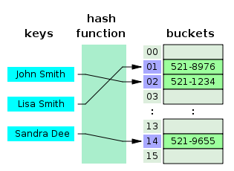
How It Works
Key passed through hash function
Returned hash is index in the array
Getting value at index returns wanted value

Slide 5
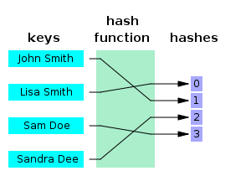
Hash Function
As simple as 1-2 machine instructions
Good hashing functions
Uniform key distribution
Avoid clustering
Low overhead

Slide 6

Disadvantages
Harder to implement than search trees
Hash function might adds overhead
Can’t find values close to one another
Hash collision probable based on quality of function
Cost of single operation may be high

Slide 7
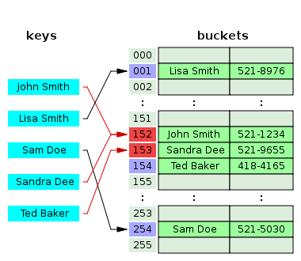
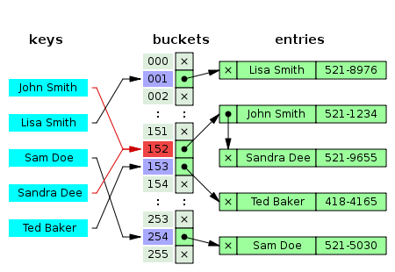
Collisions
Happens when different keys result in the same hash
Chaining
Open Addressing

Slide 8

Resizing Table
After certain load factor, table needs to be resized
Resizing by copying the whole table
Has to copy the whole table before next operation
Doubles cost of each insertion/deletion
Incremental resizing
Create new table
Move items slowly to the next table

Slide 9
C++ Example
#include "table.h" #include "list.h" tableClass::tableClass() { Size = 0; } tableClass::~tableClass() { Size = 0; /*notice i didn't go through and free up the memory, you could do this with TableDelete in a while loop if you wish*/ } void tableClass::AddToTable(int newItem) { int index = GetIndex(newItem); listPtr = &T[index]; //lets listPtr represent this element in the table listPtr.AddToList(int newItem); /*assuming this was the name of the function to add an item to the list*/ Size++; //increasing the number of items in the table } void tableClass::TableDelete(int searchKey) { int index = GetIndex(searchKey); listPtr = &T[index]; listPtr.ListDelete(int searchKey); /*assuming this was the name of the function to remove an item from the list*/ Size--; //decreasing the number of items in the table } int tableClass::GetIndex(int searchKey) { int index = searchKey%5; //our hash formula return index; }

Slide 10
Python Example
#!/usr/bin/env python
table = { #python's built-in dict data type
"John Smith" : "521-1234",
"Lisa Smith" : "521-8976",
"Sam Doe" : "521-5030",
"Sandra Dee" : "521-9655",
"Ted Baker" : "418-4165",
}
print table["John Smith"] # prints out value from key
print table.get("Sam Doe") # same as above
print table.pop("Lisa Smith") # removes and returns value with this key
table["John Doe"] = "521-4679" # adds value with key

Slide 11

Questions?
Sources: All stolen from Wikipedia

